Slide 1
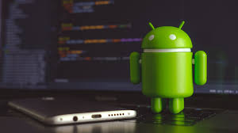
BIO TOUCH PASS: HANDWRITTEN PASSWORDS FOR TOUCH SCREEN BIOMETRICS
GUIDED BY
Mrs. J Gunaseeli
PROJECT BY
T. Selva Sathish
S. Rajadurai

Slide 2
ABSTRACT
It is user-friendly ecommerce mobile applications ensuring data protection and high security.
This work enhances traditional authentication systems based on personal identification number and one time passwords through the incorporation of biometric information as a second level of user authentication.
In our proposed approach, users draw each digit of the password on the touchscreen of the device instead of typing them as usual.
+

Slide 3
INTRODUCTION
This study evaluates the advantages and potential of incorporating biometrics to password-based mobile authentication systems, asking the users to draw each digit of the password on the touchscreen instead of typing them as usual.
This way, the traditional authentication systems are enhanced by incorporating dynamic handwritten biometric information. One example of use that motivates our proposed approach is on internet payments with credit cards.
Banks usually send a numerical password to the user’s mobile device. This numerical password must be inserted by the user in the security platform in order to complete the payment. Our proposed approach enhances such scenario by including a second authentication factor based on the user biometric information while drawing the digits.

Slide 4
EXISTING SYSTEM
In existing system, handwritten signature is one of the most socially accepted biometrics as it has been used in financial and legal agreements for many year.
These approaches are based on the combination of two authentication stages.
The security system checks the claimed user introduces its unique password correctly, and its behavioral biometric information is used for an enhanced final verification.

Slide 5
PROPOSED SYSTEM
In our proposed system, user should draw each digit of the password on the touch screen instead of typing.
The system involves two stages of authentication the drawn pin should be similar to pin entered during registration process.
User can set second stage password as stroke, time, screen brightness or sensor based authentication system.
The incorporation of biometric information on traditional password based system can improve the security through a second level authentication.

Slide 6
SOFTWARE REQUIREMENTS:
Windows 7 and above
JDK 1.7
Xampp
Android Studio 3.4
Android Phone
HARDWARE REQUIREMENTS:
Hard Disk : 500GB and Above
RAM : 4 GB and Above
Processor : I3 and Above

Slide 7
TECHNOLOGY USED:
Core java
Android
PHP
ALGORITHM:
OCR

Slide 8
ALGORITHM
OPTICAL CHARACTER RECOGNITION
OCR stands for Optical Character Recognition, which is a technology that allows computers to recognize printed or handwritten text characters from digital images of physical documents or scanned paper documents. OCR algorithms are designed to analyze the image of the text characters, identify the patterns in the characters, and convert them into machine-encoded text that can be used for further processing.

Slide 9
WORKING OF OCR
The basic steps involved in the OCR algorithm used in the above code:
Load the image: The input image containing the text is loaded into the program.
Preprocessing: The image is preprocessed by converting it to grayscale, applying noise reduction techniques, and adjusting the contrast to enhance the quality of the image.
Text detection: The program detects the regions of the image where text is present using various techniques like the Stroke Width Transform (SWT), Edge Detection, or Connected Component Analysis (CCA).
Text Recognition: The detected text regions are then processed using Optical Character Recognition (OCR) algorithms, which extract the text from the image and convert it into machine-readable text.
Postprocessing: The extracted text is post-processed to correct errors and improve the accuracy of the OCR output. Techniques like language models, spell-checking, and grammar checking can be used for this purpose.
Output: The final output is the extracted and processed text, which can be used for further analysis or storage.

Slide 10
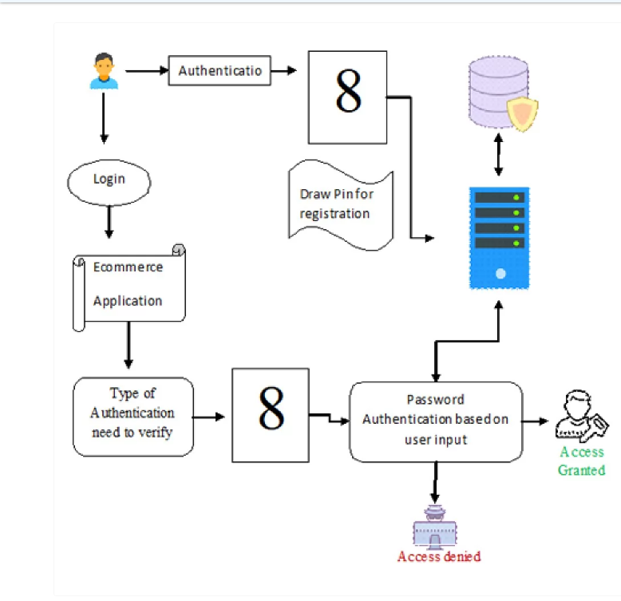
ARCHITECTURE DIAGRAM

Slide 11
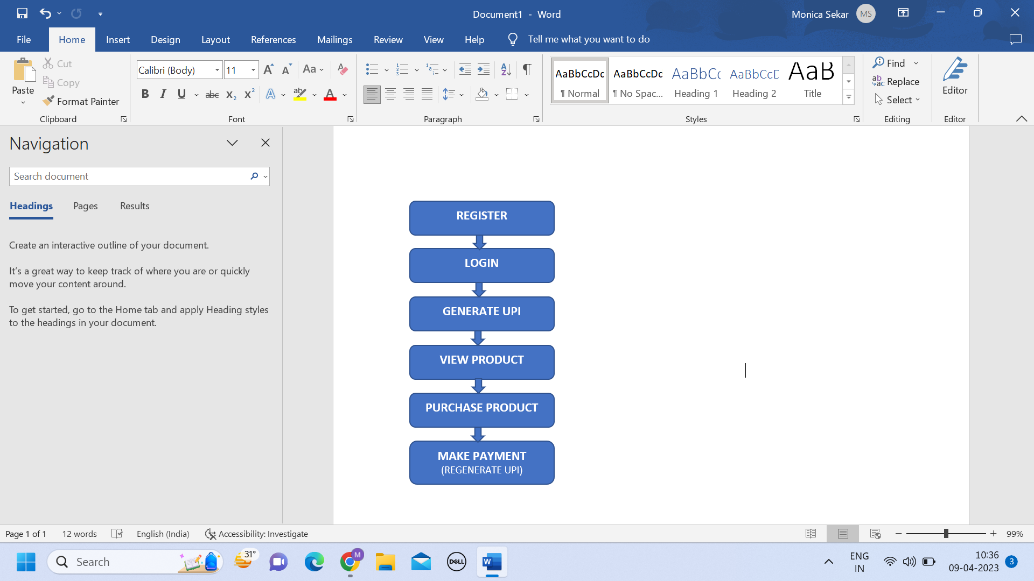
WORKFLOW

Slide 12
MODULES
User Authentication and Ecommerce view product.
Biometric Password Using Strokes.
Cart and payment using Biometric Hand Written password.
Biometric Password Using Screen Brightness and Time.

Slide 13
USER AUTHENTICATION AND E-COMMERCE VIEW PRODUCT
User has an initial level Registration Process. The users provide their own personal information for this process. The server in turn stores the information in its database and user can view a list of products in their page multiple list of products and their details.

Slide 14
BIOMETRIC PASSWORD USING STROKES
User has to register their four digit password with multiple strokes during their registration process once the process completed during confirm password .User has to confirm their password with same password with stroke has to be verified. Strokes for each drawn digits should match with strokes given at time of registration.

Slide 15
CART AND PAYMENT USING BIOMETRIC HAND WRITTEN PASSWORD
User can select a list of product they wish to purchase the selected product will be listed in a cart page and user can initiate general purchase information has to be filled. Completing general detail user has to draw their four digit pin one by one on screen. The drawn password then converted into an image through optical character recognition numbers from each image fetched and verified with user password.

Slide 16
BIOMETRIC PASSWORD USING SCREEN BRIGHTNESS AND TIME
Spyware attack will be avoided by proposing the idea that uses the screen brightness as an authentication tool. The android secure environment generates the 6 digit binary value. Based on the binary digit the brightness of the screen gets changed to high or low. Else the user should give the wrong and random PIN number. The system will remove the digits which inserted while the screen brightness is low and apply the H Mac algorithm for the PIN given by user and generate the Signature for the user PIN which is a digestible Value in order to avoid MAN-IN-MIDDLE attack.
The server gets the signature of user generated PIN and generates the signature value for the Original PIN and compare two signatures. If the two Signatures are equal the user can access the Profile of the user. If not user can’t access the profile.

Slide 17
SCREENSHOTS OF ACCOUNT CREATION

Slide 18
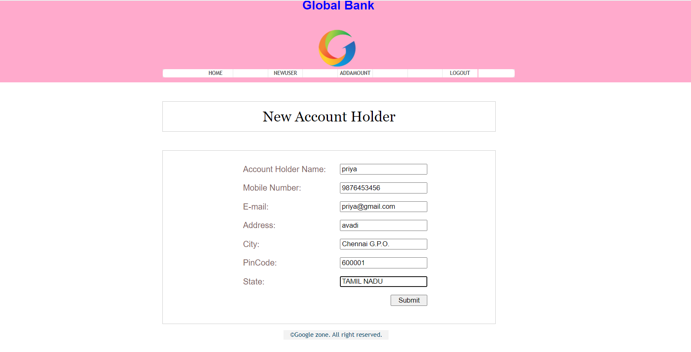

Slide 19
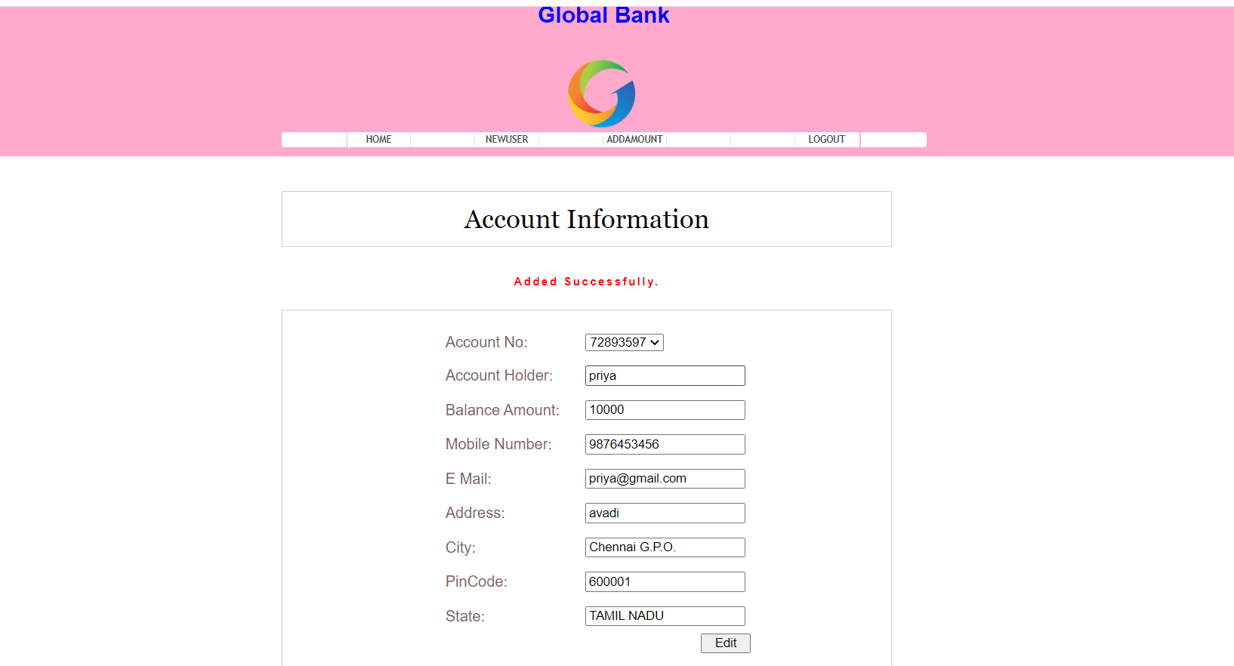

Slide 20
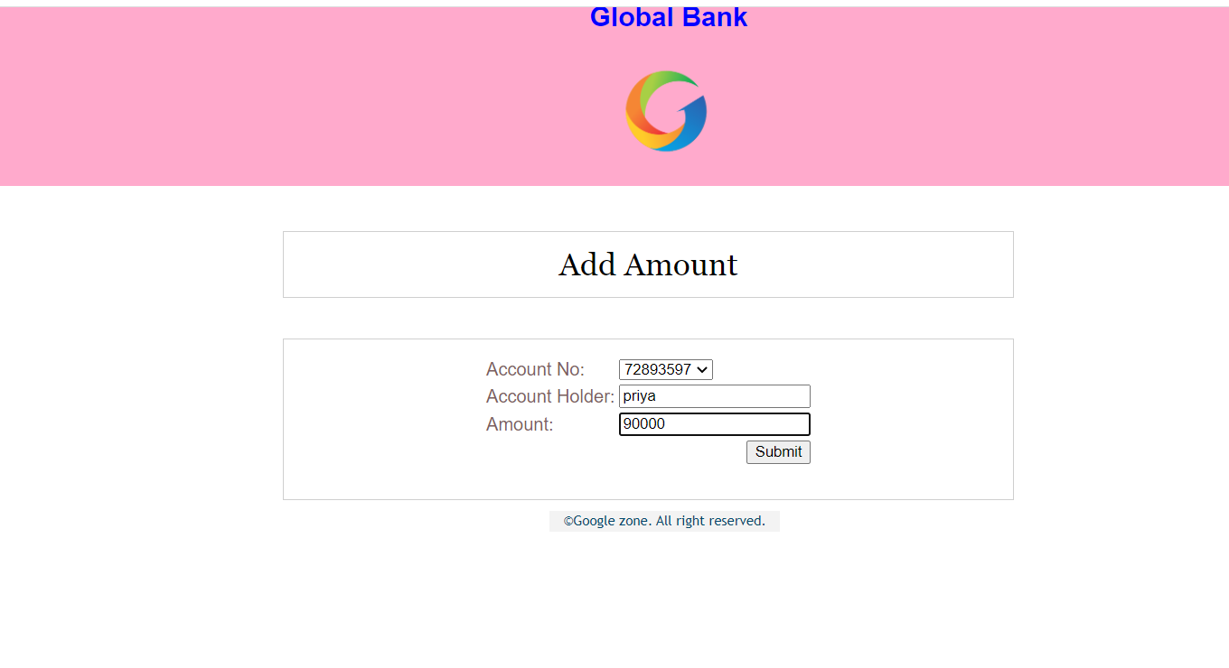

Slide 21
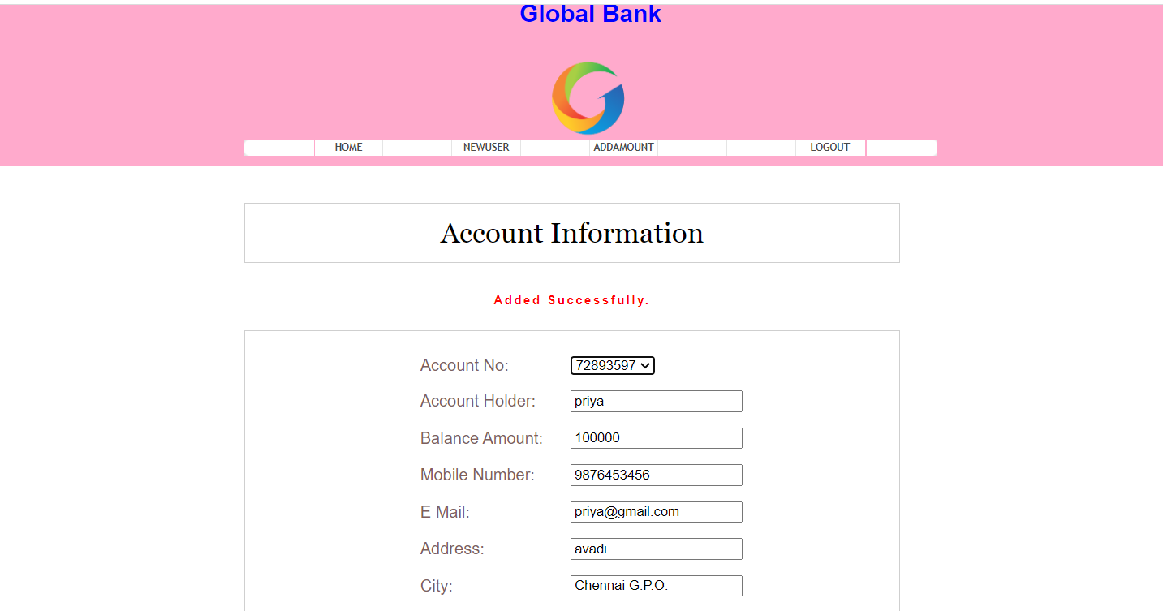

Slide 22
REGISTER AND LOGIN

Slide 23
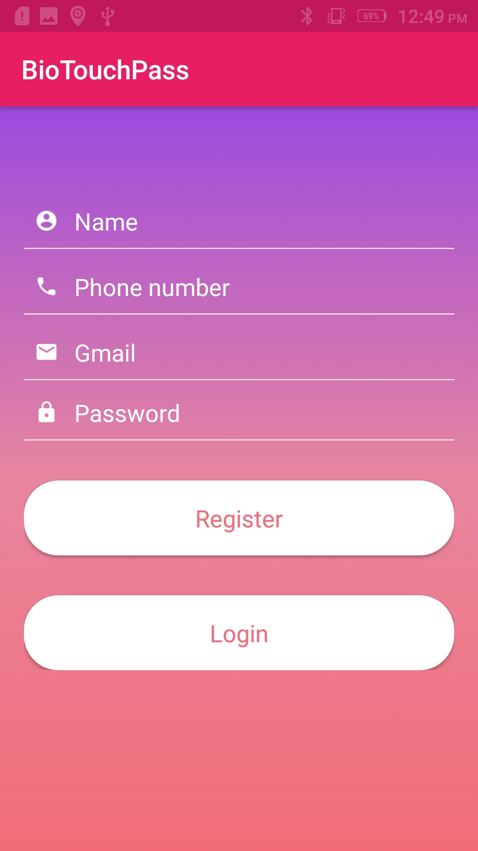
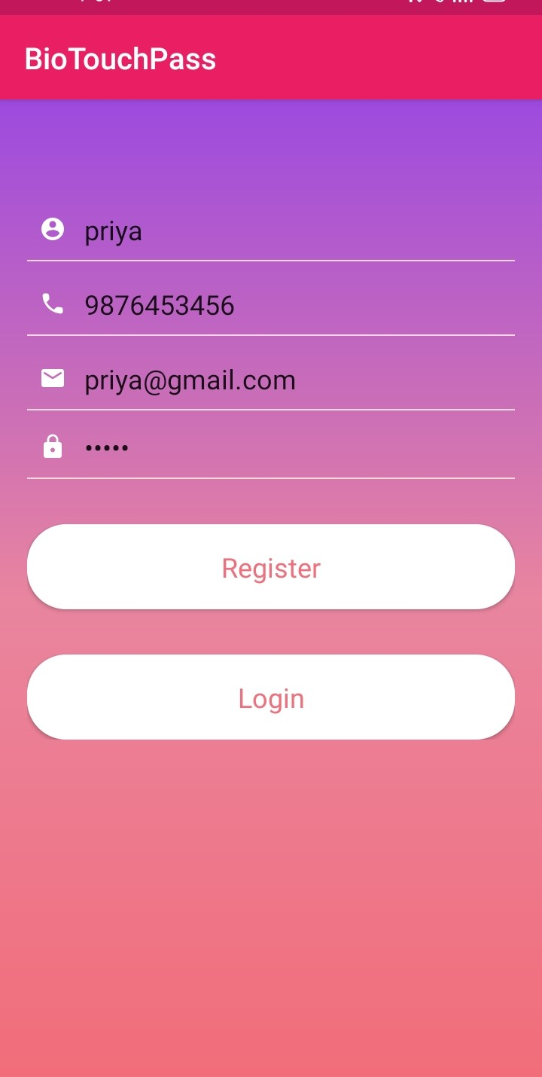

Slide 24
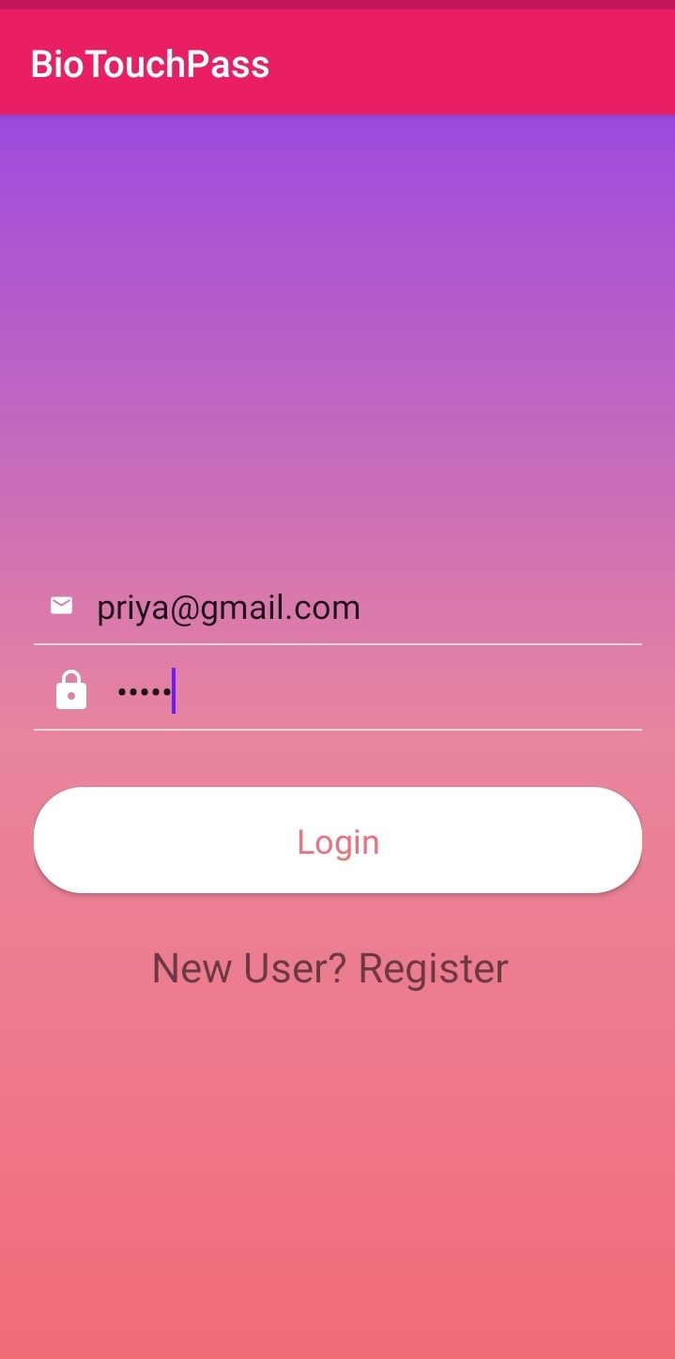
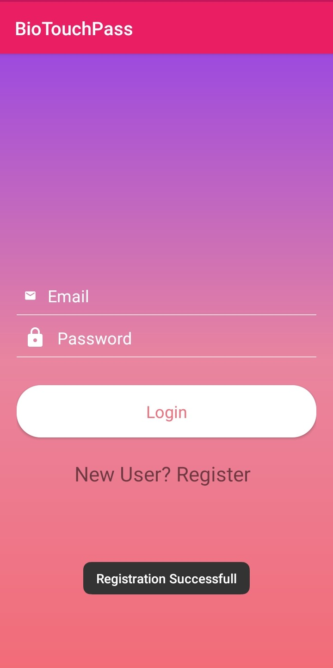

Slide 25
UPI GENERATION

Slide 26
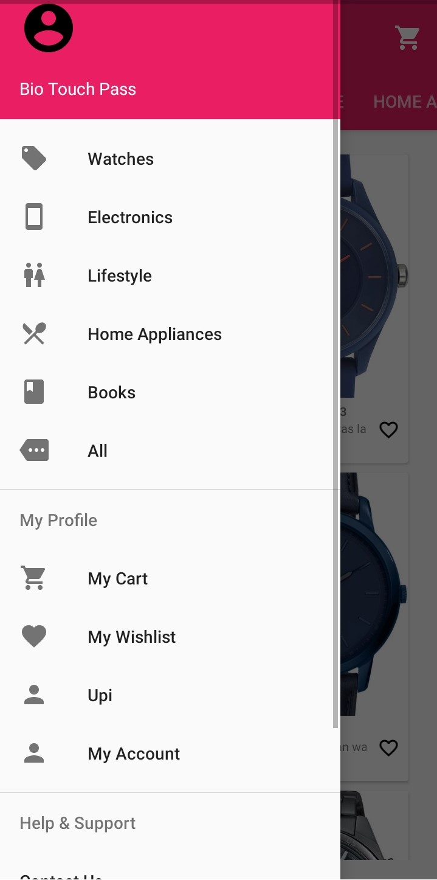
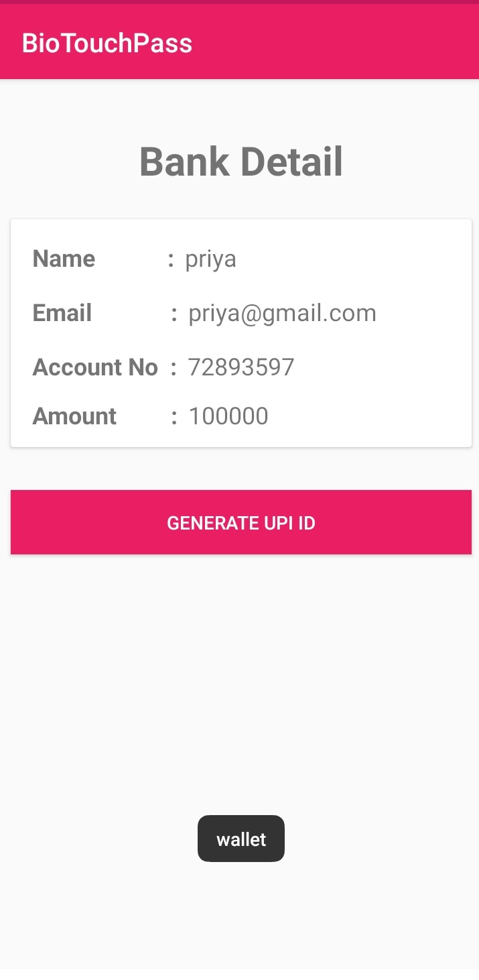

Slide 27
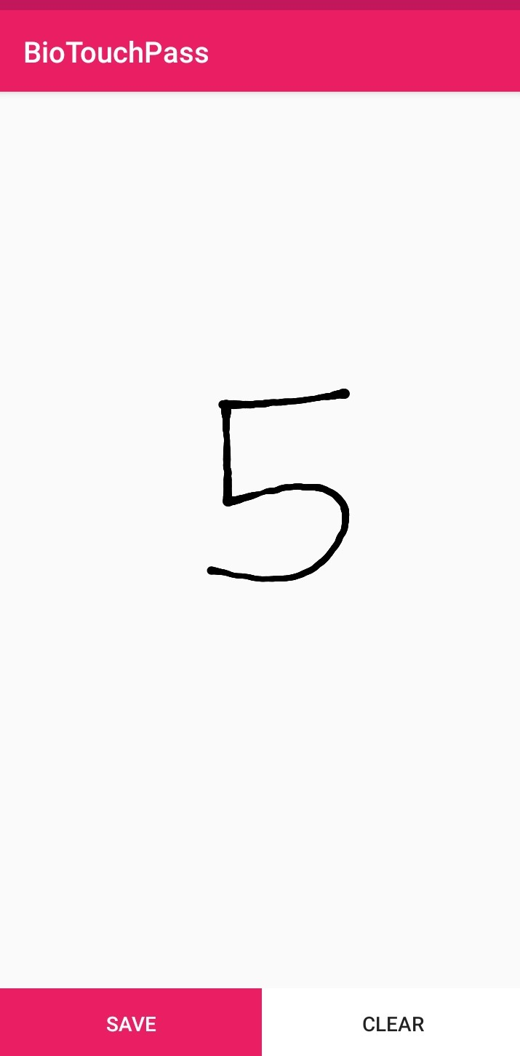
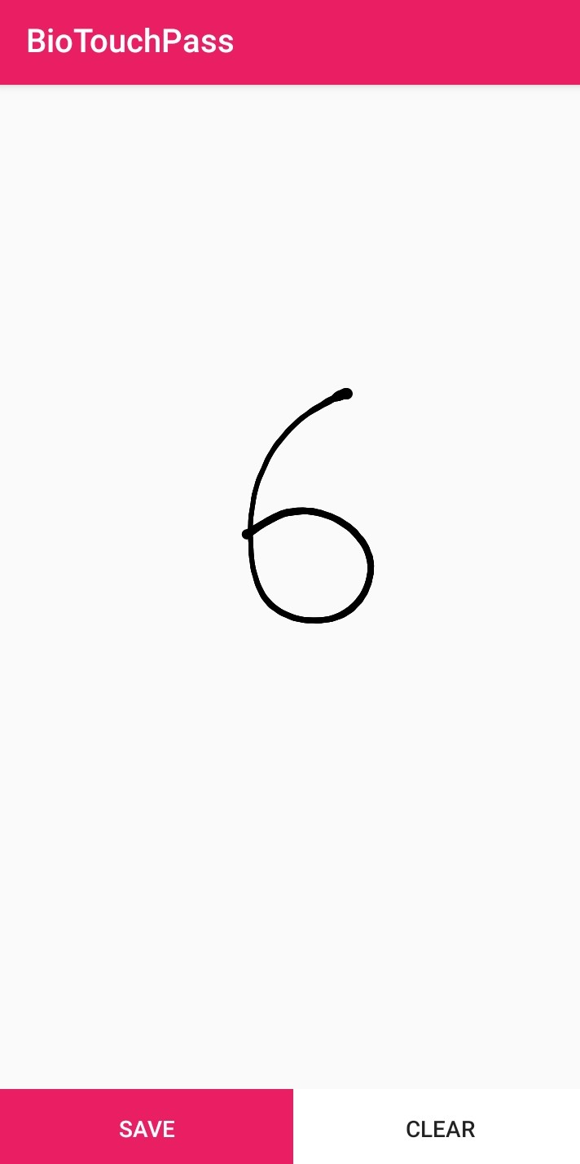
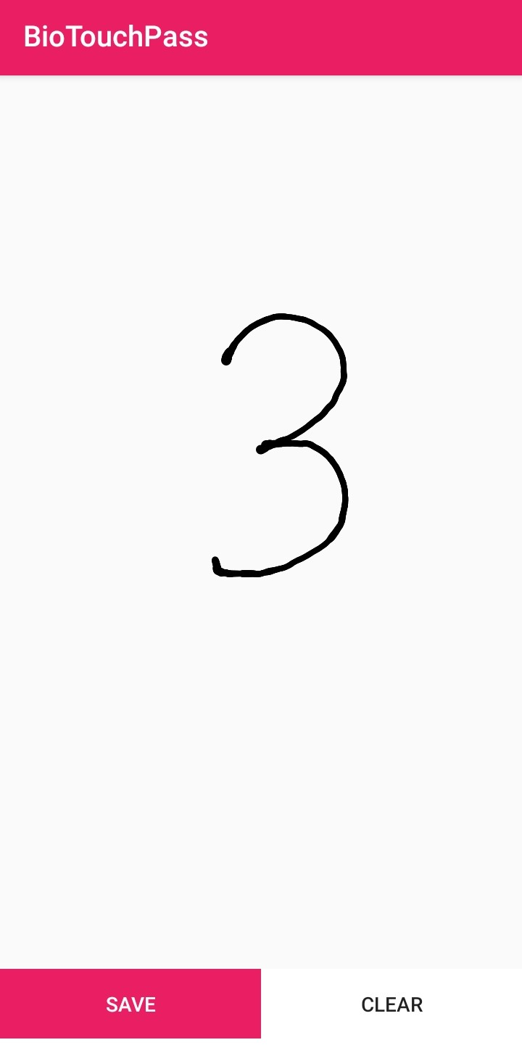
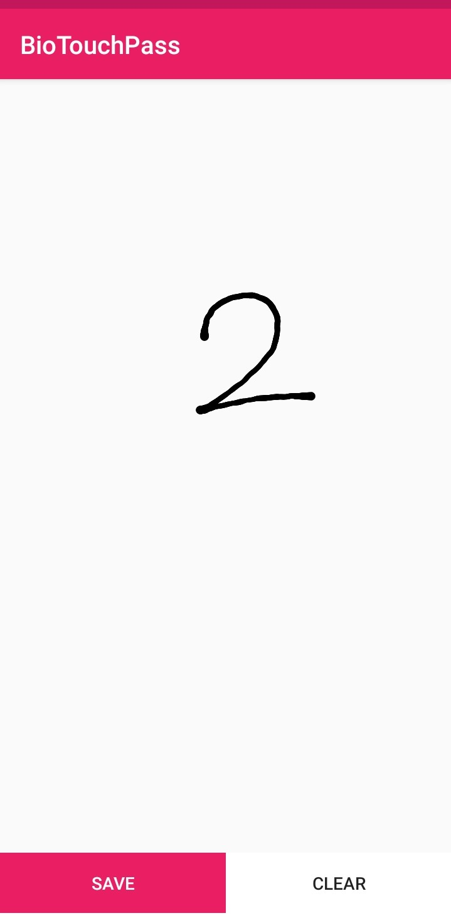
CREATING UPI PIN​

Slide 28
PLACING AN ORDER

Slide 29
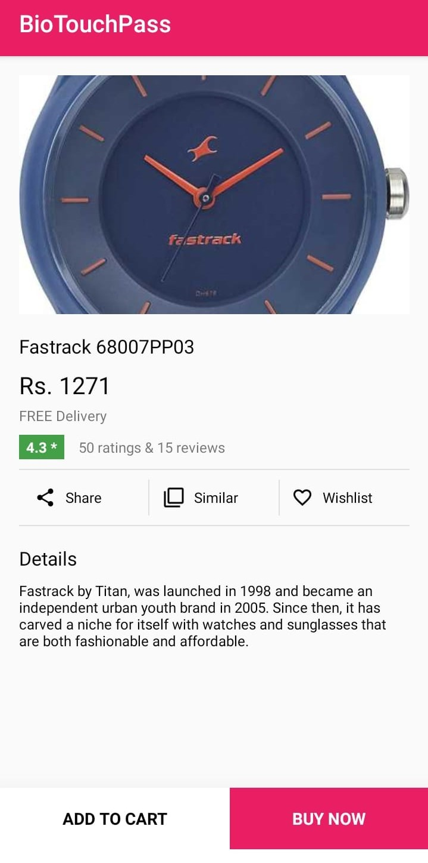
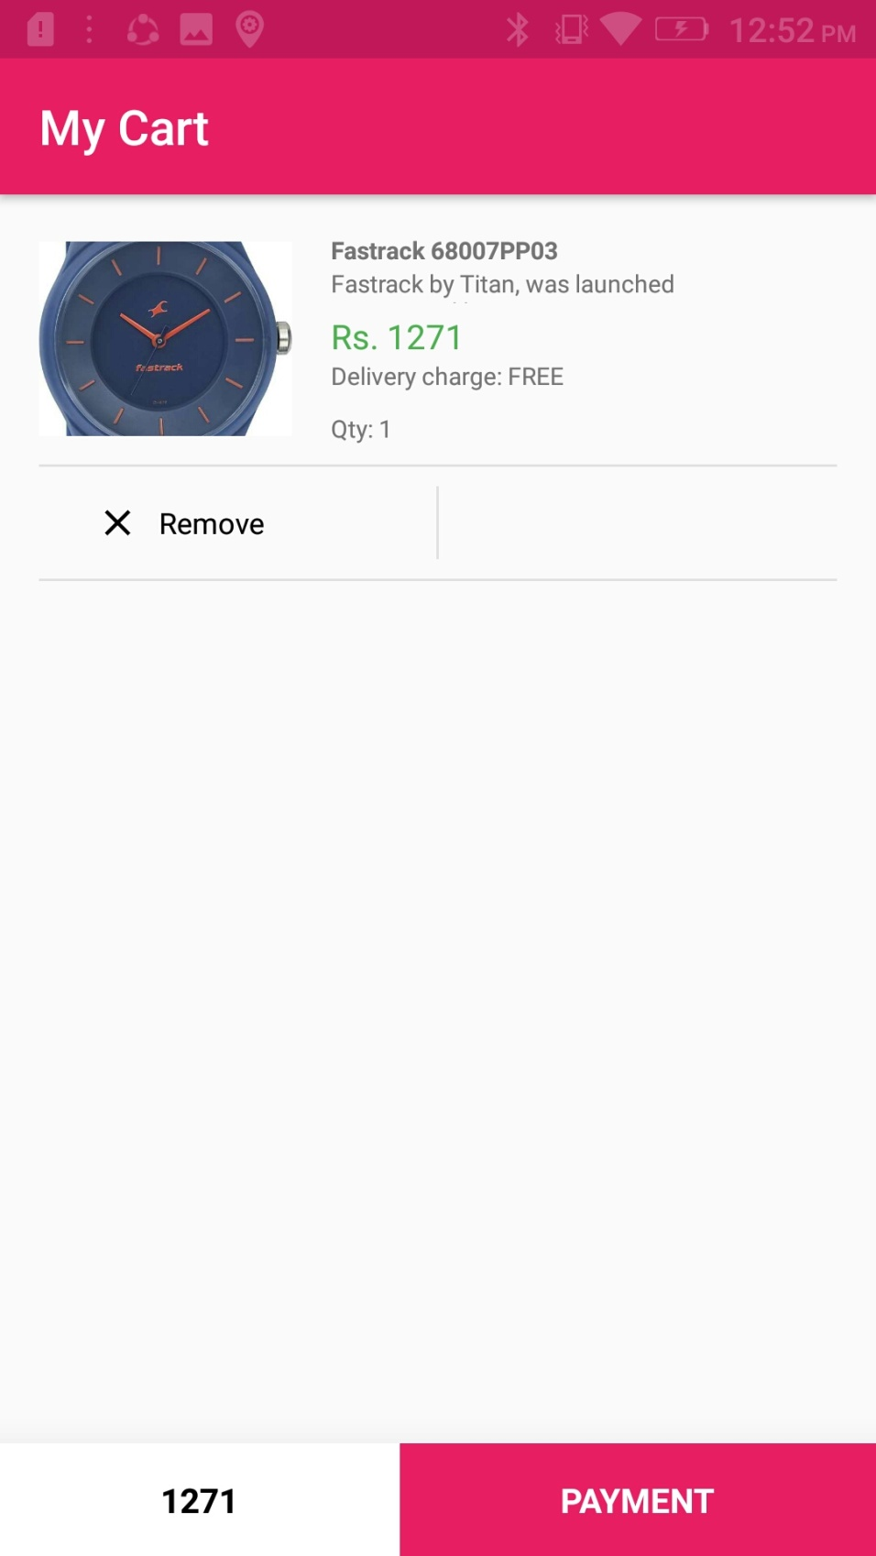

Slide 30
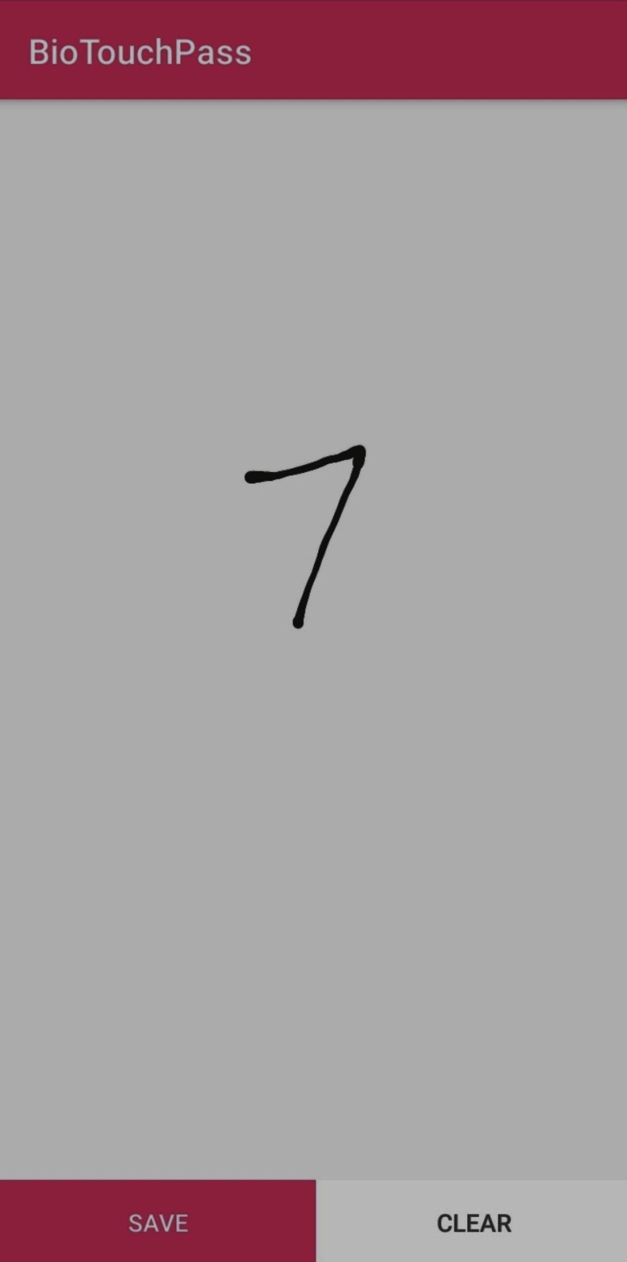
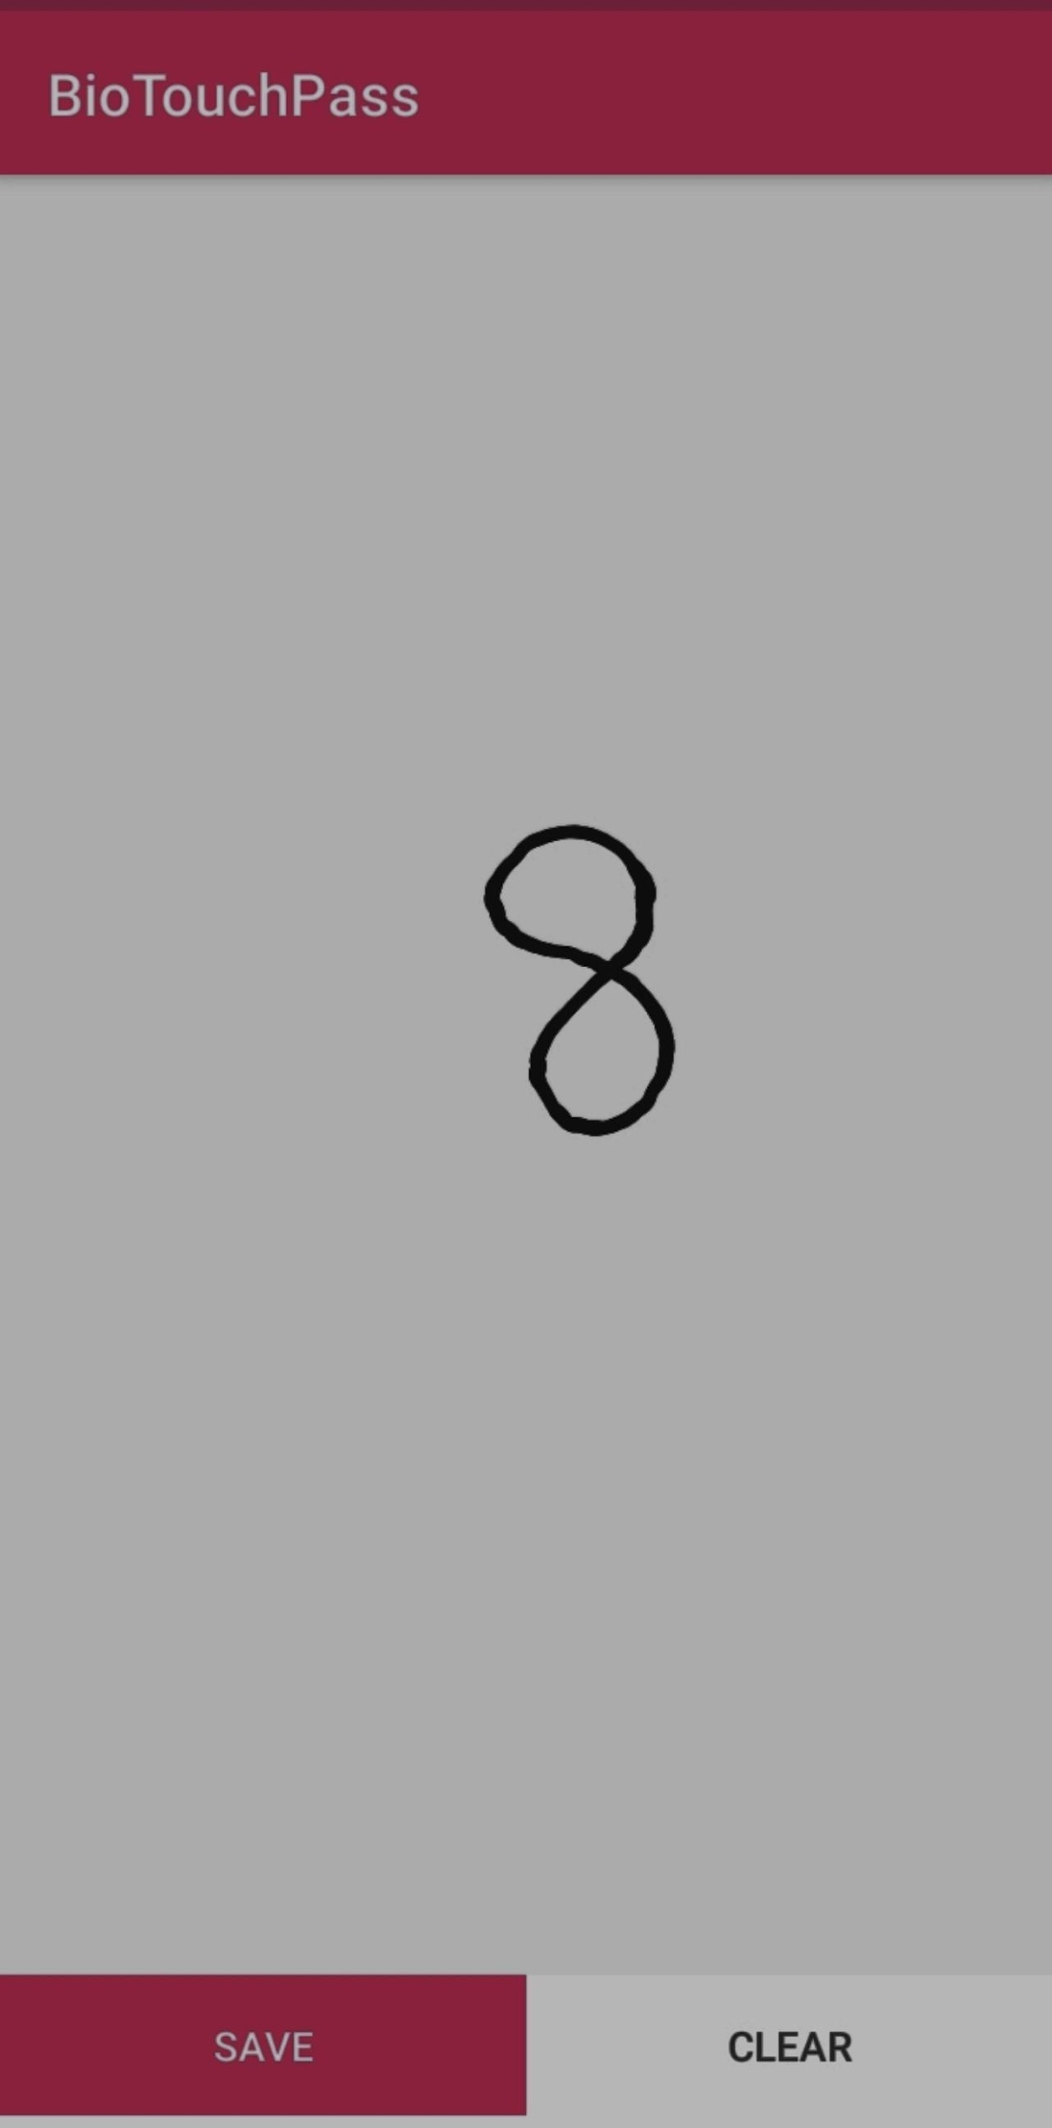
ENTERING UPI PIN​

Slide 31
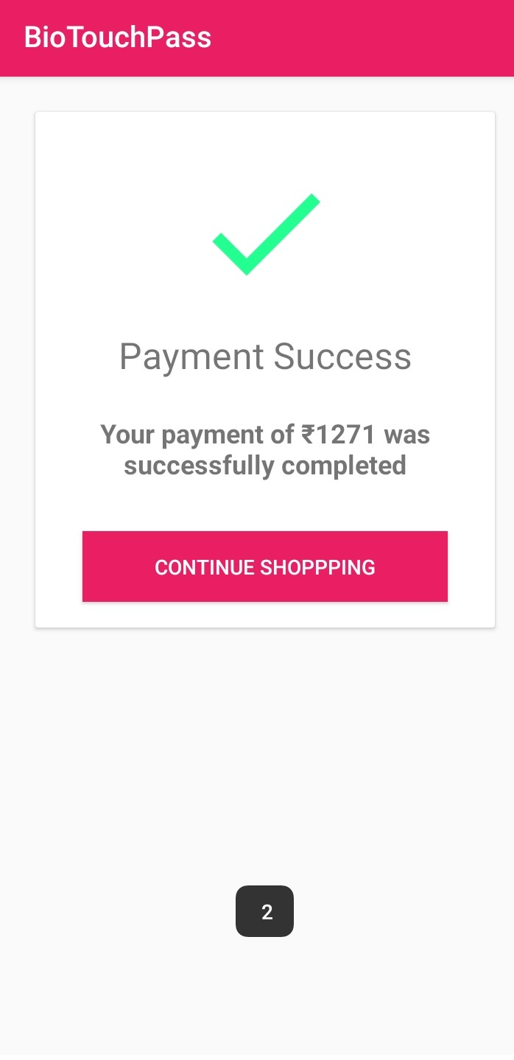

Slide 32
CONCLUSION
We propose the smart way to authenticate the social networking accounts belonging to them by using the screen brightness of android mobiles in order to avoid the spyware attack, shoulder surfing attack and man in the middle attack.

Slide 33
REFERENCES
[1] J. Fierrez, A. Pozo, M. Martinez-Diaz, J. Galbally, and A. Morales, “Benchmarking Touchscreen Biometrics for Mobile Authentication,” IEEE Trans. on Information Forensics and Security, vol. 13, 2018.
[2] J. Galbally, I. Coisel, and I. Sanchez, “A New Multimodal Approach for Password Strength Estimation Part I: Theory and Algorithms,” IEEE Transactions on Information Forensics and Security, vol. 12, pp. 2829– 2844, 2017.
[3] P. Lacharme and C. Rosenberger, “Synchronous One Time Biometrics With Pattern Based Authentication,” in Proc. 11th Int. Conf. on Availability, Reliability and Security, ARES, 2016.
[4] A. Aviv, K. Gibson, E. Mossop, M. Blaze, and J. Smith, “Smudge Attacks on Smartphone Touch Screens,” in Proc. of the 4th USENIX Conference on Offensive Technologies, 2010, pp. 1–7.
[5] M. Liang and X. Hu, “Recurrent Convolutional Neural Network for Object Recognition,” in Proc. of the IEEE Conference on Computer Vision and Pattern Recognition, 2015, pp. 3367–3375.
[6] P. Lacharme and C. Rosenberger, “Synchronous One Time Biometrics With Pattern Based Authentication,” in Proc. 11th Int. Conf. on Availability, Reliability and Security, ARES, 2016.
[7] D. Buschek, A. D. Luca, and F. Alt, “There is more to Typing than Speed: Expressive Mobile Touch Keyboards via Dynamic Font Personalisation,” in Proc. of the International Conference on Human- Computer Interaction with Mobile Devices and Services, 2015, pp. 125– 130.
[8] “Improving Accuracy, Applicability and Usability of Keystroke Biometrics on Mobile Touchscreen Devices,” in Proc. of the CHI Conference on Human Factors in Computing Systems, 2015, pp. 1393–

